Slide 1

solar Panel Sales Analysis
Challenges & Opportunities
Performance Analysis
Profitability Metrics
Total KPI Overview
Sales Trend Analysis
Panel Sales by Year

Slide 2
Challenges & Opportunities
Performance Analysis
Profitability Metrics
Total KPI Overview
Sales Trend Analysis
Panel Sales by Year

Slide 3
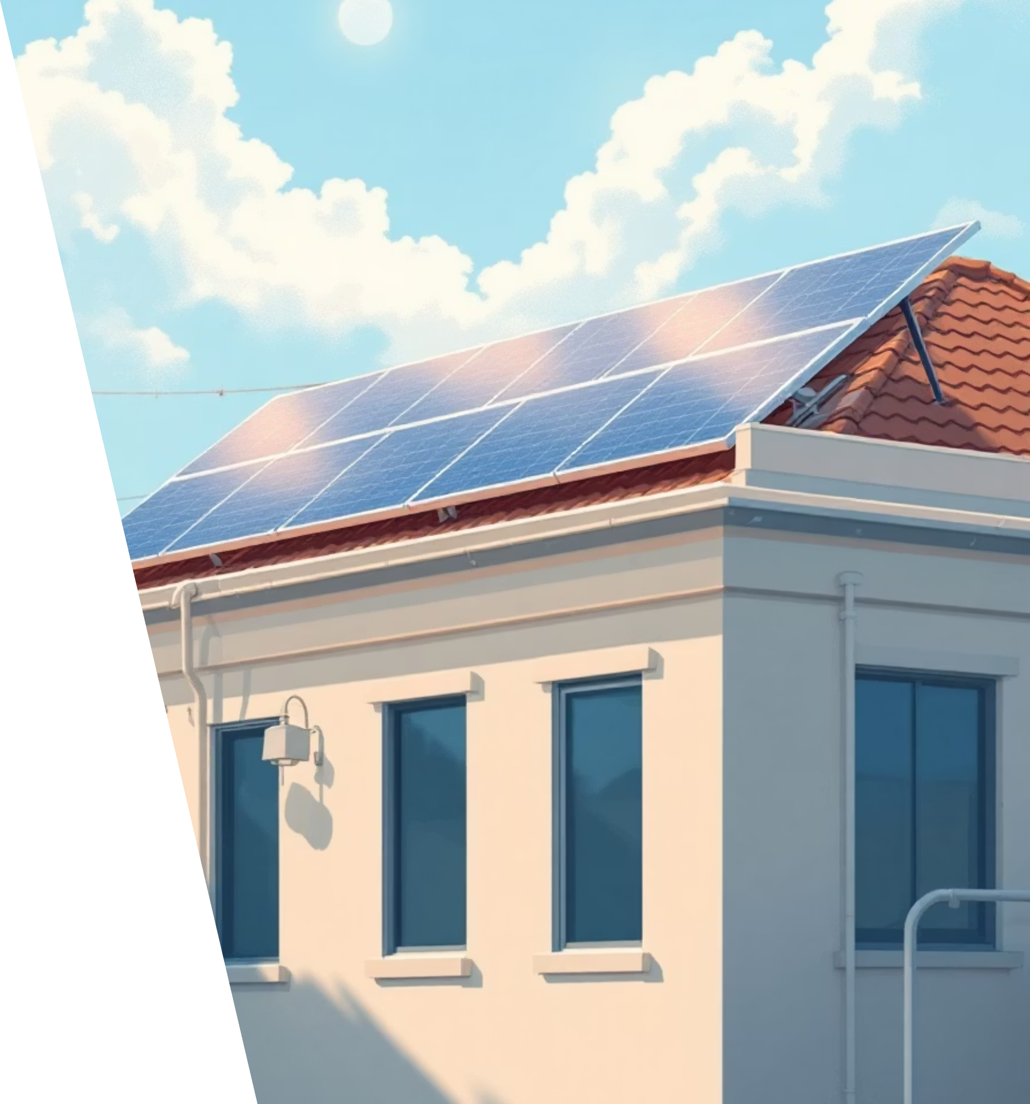
Solar Panel Sales Performance Analysis – 2022 to 2025
Overview of global solar panel sales trends and profitability.
Performance insights derived from Power BI dashboard analytics.
Focus: sales growth, regional performance, profit margins, and key customers.

Slide 4
Executive Summary
$548.45M
$150.78M
51.29K
Total Sales
Total Profit
Orders Fulfilled
across all regions
with a 27.49% profit margin
total quantity sold of 539K units
Solid upward trend in solar adoption and profitability metrics.

Slide 5

Total KPI Overview
Profit Margin
Avg Sales per Order
Profit per Order
27.49% — indicating healthy operational efficiency.
$10.69K, showing strong average transaction size.
$2.94K
Sales Growth
Profit Growth
5%
31.81% year-over-year
KPI Insight: Strong profitability with moderate sales expansion – a sustainable growth pattern.

Slide 6

Sales Trend Analysis
Monthly sales remained stable between $46M–$50M.
Decline observed in Q4 (Oct–Dec) – potential for seasonal optimization.
Strategic focus: maintain consistent order volume during lower quarters.

Slide 7



Panel Sales by Year
2025 Projection
Mono-crystalline Panels
R&D Investment
Strong recovery – 108.83M in thin-film sales.
Dominate consistently with ~49M units annually.
Continuous investment in thin-film technology has boosted share.
KPI Highlight: Product diversification drives steady annual growth.

Slide 8






Regional Sales Performance
Central Region
South
EMEA
$118.15M in total sales
$71.24M
$54.15M
Leads all regions
Opportunity Zones
Decision Insight
Africa and Oceania regions with growing potential.
Expand marketing and partnerships in underperforming regions.

Slide 9
Sales by Region (2022–2025)
Consistent dominance from Central region across all years.
Steady performance from Africa and EMEA, moderate growth pattern.
2025 dip in multiple regions indicates market correction.
Strategic KPI: Balance regional dependency to sustain long-term stability.

Slide 10
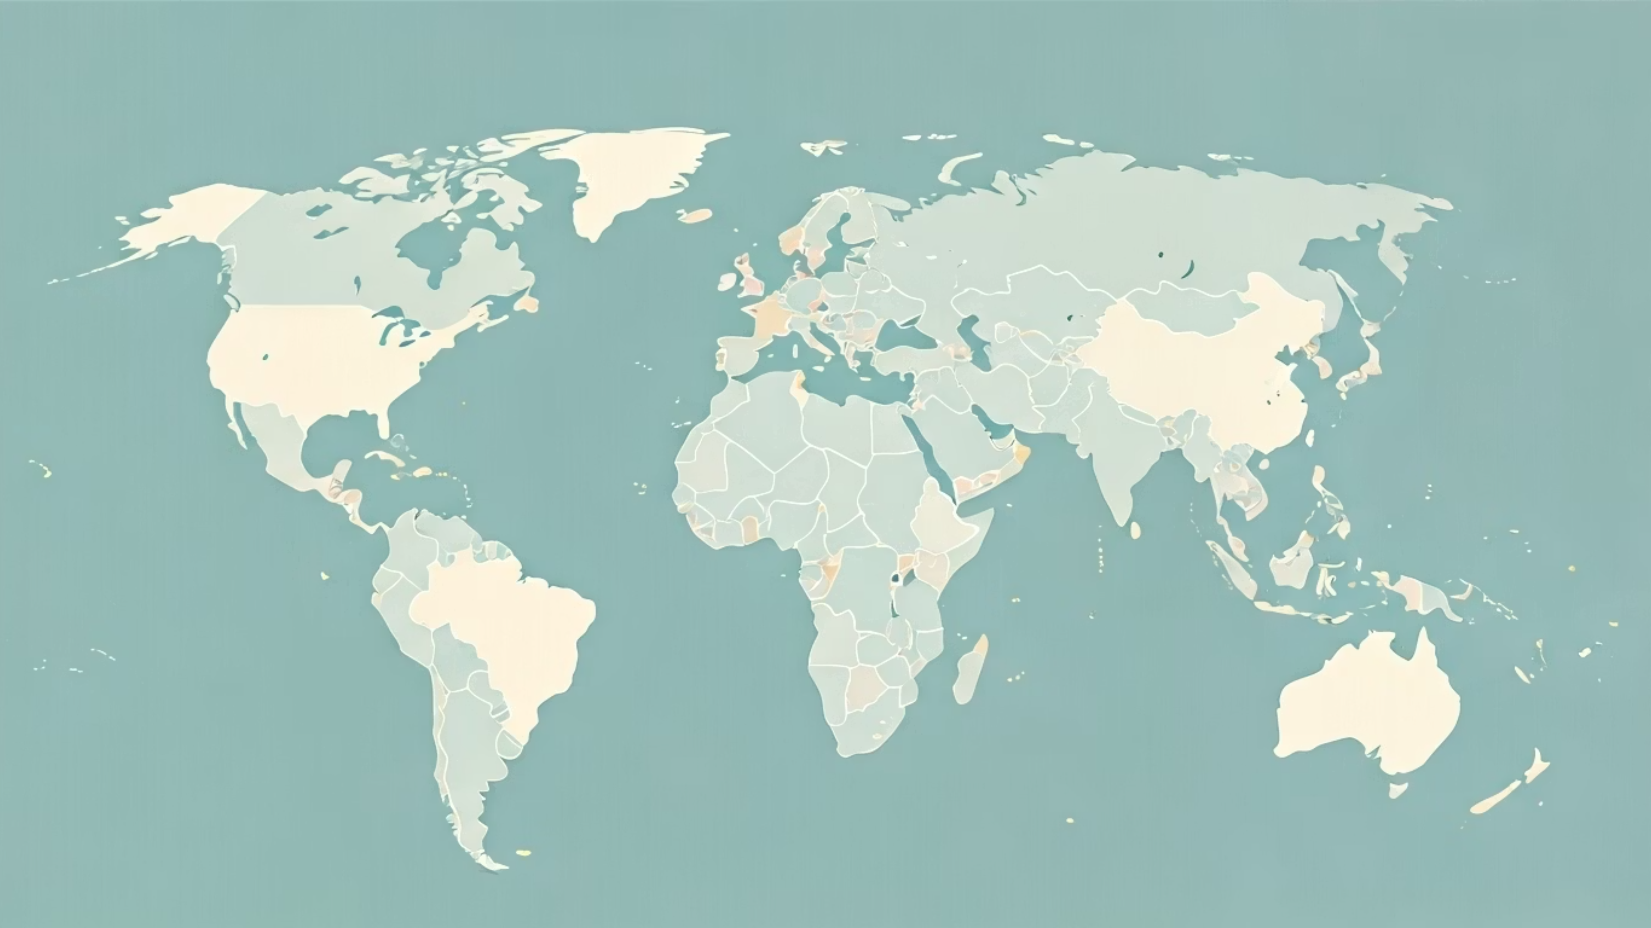
Sales by Country (Map View)
Global footprint visible with strong activity in North America, Europe, and Asia.
Expanding penetration in Africa and Oceania markets.
KPI Focus: Country-level insights enable better distribution and logistics planning.

Slide 11
Customer Insights
David Sharma
Mei Chen
Ananya Sharma
Generating over $4.2M+ in total sales
Generating over $4.2M+ in total sales
Generating over $4.2M+ in total sales
Long-term relationships with high-value clients are key profitability drivers.
Decision Metric: Strengthen customer retention programs for top 10 buyers.

Slide 12
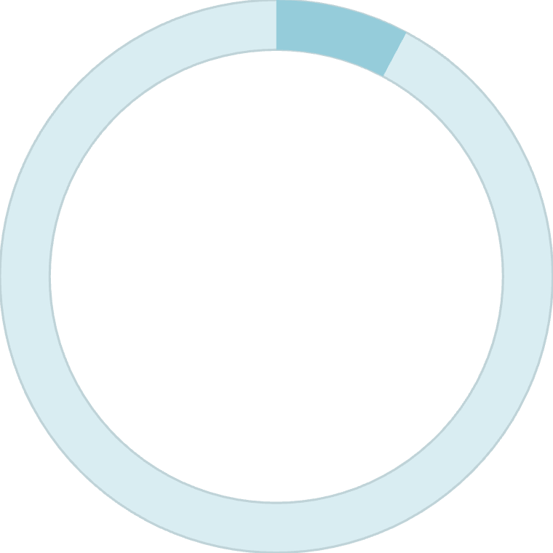
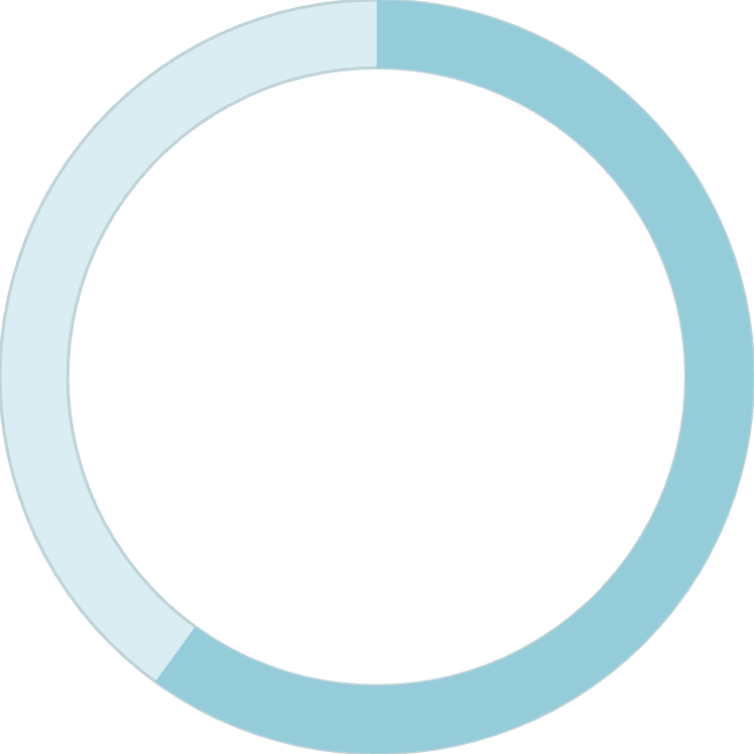
Company Partnerships
Top B2B partners include Canadian Solar, JA Solar, Jinko Solar, and LONGi Solar.
$7.8M+
60%
Each Partner Contribution
Revenue Share
in total sales
from these partnerships
KPI Highlight
Recommendation
These partnerships contribute to ~60% of total revenue.
Explore volume discounts and co-marketing initiatives.

Slide 13

Profitability Metrics
Key performance indicators driving solar business success

Slide 14
Financial Performance
Profitability Metrics
$144.38M
$124.91
10.5
Profit after Shipping
Shipping Cost per Order
Avg Quantity per Order
Total profitability after logistics costs
Average logistics expense per transaction
Units per customer transaction
KPI Insight: Logistics efficiency is a key profitability lever.

Slide 15
Capacity & Efficiency
6.00 kW
$489.78
Average Capacity Ordered
Profit per kW
Per order capacity measurement
Strong ROI indicator
Focus on increasing per-order capacity for higher profitability.

Slide 16
Growth Indicators
Sales Growth
Profit Growth
5%
31.81%
YOY — consistent upward trend
Indicates cost efficiency and pricing power
KPI Strategy: Leverage operational insights to sustain profit-led growth.

Slide 17

Challenges & Opportunities
Challenges
Opportunities
Market saturation in Central region
Africa & Oceania expansion
Seasonal drops in Q4
Thin-film product growth
Improved supply chain
Decision Insight: Reallocate marketing spend to emerging high-margin regions.
Strategic Recommendations & Conclusion
Maintain focus on high-profit partnerships and thin-film innovation.
Expand into underrepresented regions to diversify revenue base.
Enhance supply chain and Q4 performance with targeted campaigns.
Closing KPI Message: Data-driven strategy ensures sustainable and scalable solar growth

